Slide 1
Introduction to Artificial Intelligence (AI) and Machine Learning (ML)
Presented by : Irfan Noordin

Slide 2
Irfan Noordin - Dean Kuala Lumpur School of AI
Kuala Lumpur School of AI (KLSAI)
Community initiative where we educate people on topics related to Data Science and Machine Learning
Facebook - https://www.facebook.com/groups/kualalumpurschoolofai
Telegram - https://t.me/joinchat/GSvGjxKePyyoCfHyX7NpzQ
A little bit about myself ….
Graduated in Mechanical Engineering
Started career in Data Science in 2017
Currently a Data Scientist at iSaham

Slide 3
Artificial Intelligence
A computer systems able to perform tasks normally requiring human intelligence ( Oxford Reference )
Machine Learning and Deep Learning are included under the umbrella of AI

Slide 4
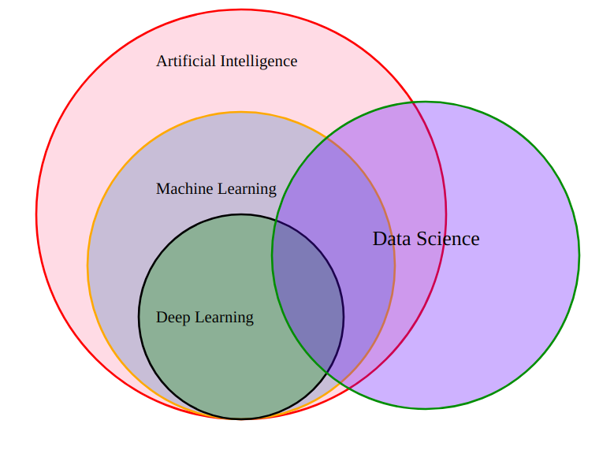
Venn Diagram for AI, ML, DL and Data Science Relationship

Slide 5
Machine Learning
“Field of study that gives computers the ability to learn without being explicitly programmed.” - Arthur Samuel (1959)
Machine learning programs, in a sense, adjust themselves in response to the data they’re exposed to.

Slide 6
Deep Learning
Deep learning is a subset of machine learning. Usually, when people use the term deep learning, they are referring to deep artificial neural networks
Deep is a technical term. It refers to the number of layers in a neural network.
Deep artificial neural networks are a set of algorithms that have set new records in accuracy for many important problems, such as image recognition, sound recognition, recommender systems, etc. For example, deep learning is part of DeepMind’s well-known AlphaGo algorithm

Slide 7

CS231n Convolutional Neural Networks for Visual Recognition

Slide 8
Machine Learning

Slide 9
Major Categories of Machine Learning
Supervised - Prediction based on labelled data
Classification (cancer detection)
Regression (house price prediction)
Unsupervised Machine Learning - Finding similarities in unlabeled data
Grouping of similar data (clustering)
Outlier Detection
Reinforcement Learning
Behavior changes based on rewards provided

Slide 10
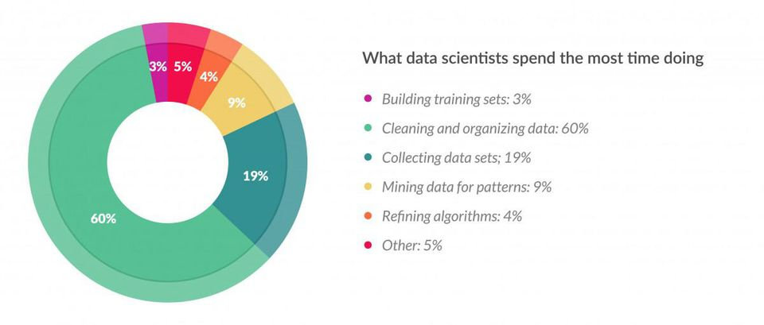
How do you build a Machine Learning Model ?
Collect data
Clean data
Label data
Choose Suitable algorithm
Train model
Test
Repeat
Until obtain acceptable performance
https://www.forbes.com/sites/gilpress/2016/03/23/data-preparation-most-time-consuming-least-enjoyable-data-science-task-survey-says/?sh=420f8776f637

Slide 11
Example of a Machine Learning Model

Slide 12
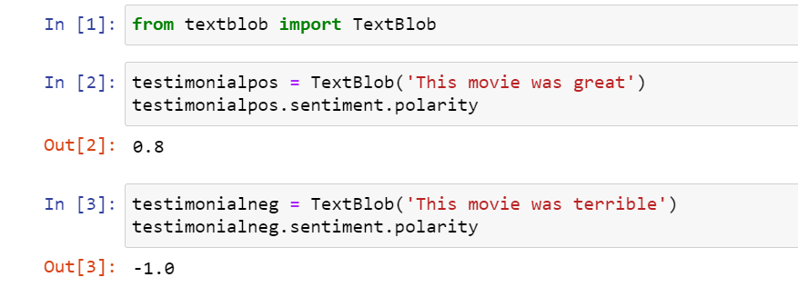
Example of a Machine Learning Model

Slide 13
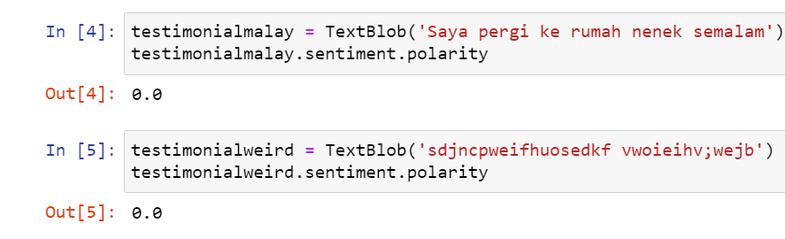
Example of a Machine Learning Model

Slide 14
Examples of Visualizations using Machine Learning

Slide 15
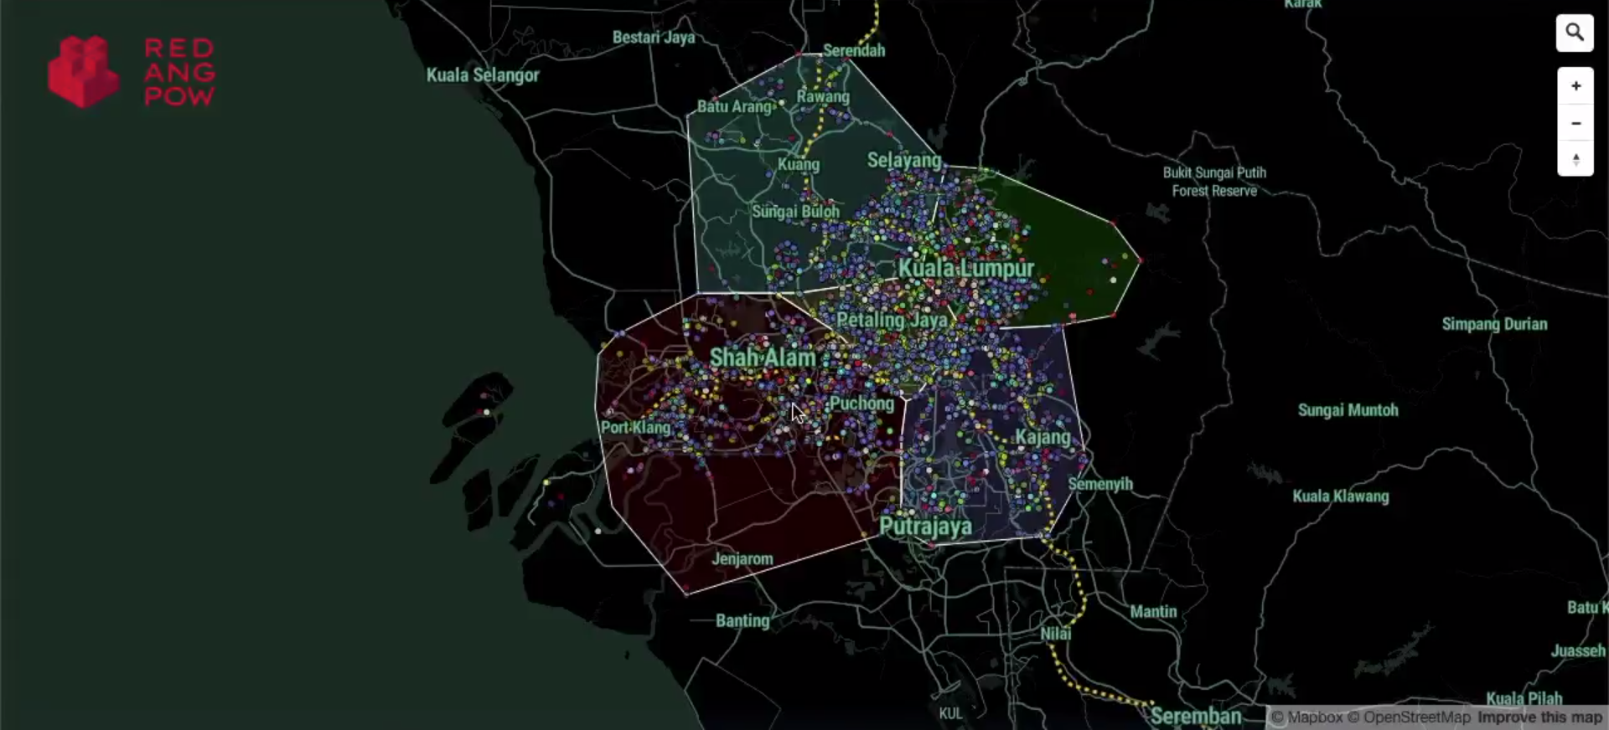
Clustering - Point of Interests (POI) in Klang Valley
https://www.linkedin.com/posts/faizal-abd-kadir_geospatial-datascience-visualization-activity-6702433761721643008-zwhK

Slide 16
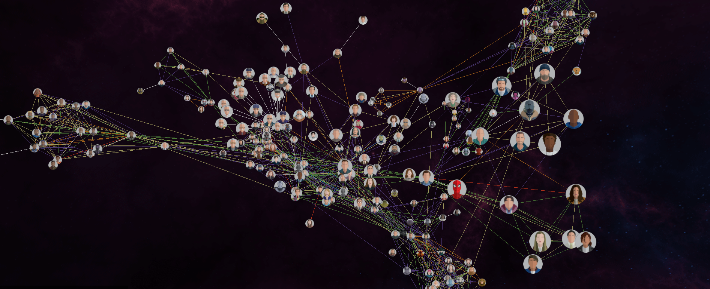
Marvel Cinematic Universe - Network Graph
Marvel Cinematic Universe

Slide 17
Where are we now?
In terms of AI ?

Slide 18
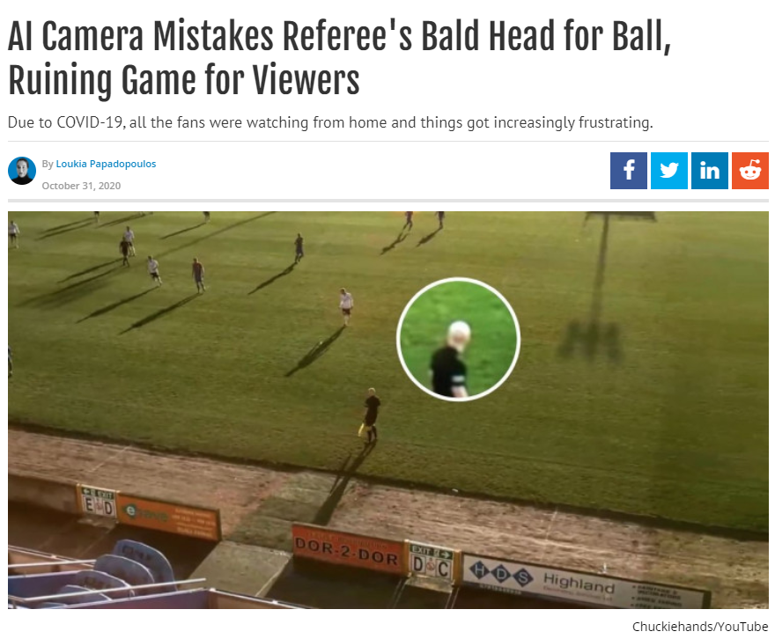
AI Camera Mistakes Referee's Bald Head for Ball, Ruining Game for Viewers

Slide 19
GPT-3
Open-AI’s advanced language prediction model.
https://www.youtube.com/watch?v=4ow0Qwhy1-c&feature=youtu.be&t=13&ab_channel=AIBasics

Slide 20
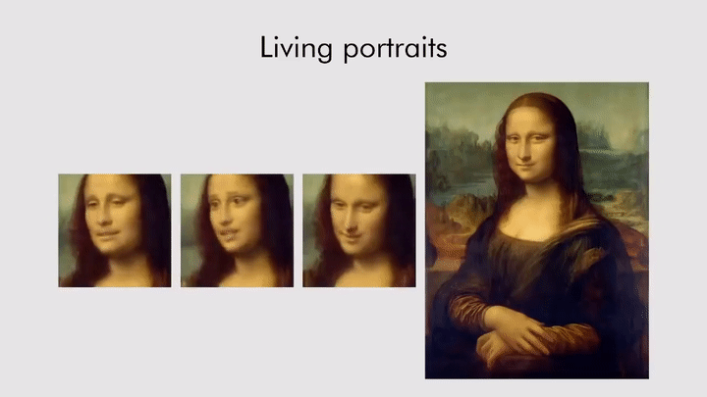
GANs
Artificial Intelligence Brings Mona Lisa To Life Using GANs

Slide 21
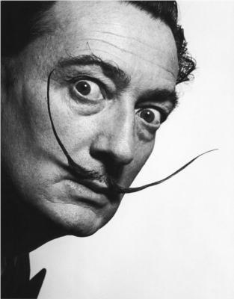
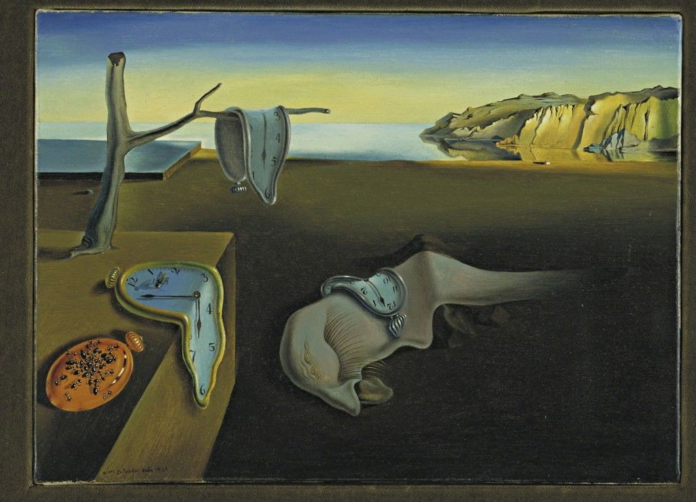
Salvador Dali ( 1904-1989 )
Salvador Dali - 1170 artworks - painting
What You Need to Know about Salvador Dalí

Slide 22
Links (Salvador Dali)
https://www.youtube.com/watch?v=BxlPCLRfk8U&ab_channel=Welcome.AI
https://www.youtube.com/watch?v=BIDaxl4xqJ4&ab_channel=TheDaliMuseum

Slide 23
Machine Learning & Deep Learning Tools

Slide 24



Machine Learning Tools
Python / R
Anaconda
Jupyter notebook
Scikit Learn

Slide 25
Deep Learning Tools
Google TensorFlow
PyTorch
Keras
Caffe

Slide 26
Resources

Slide 27
Resources :
Cognitive Class - Free
Cognitive Class: Data Science and Cognitive Computing Courses
Kaggle ( Dataset & Examples Source )
www.kaggle.com
Rapid Experimentation
Start Googling
Test codes

